Slide 1

Stakeholder Mapping Workshop
Shared Risk
vmia.vic.gov.au

Slide 2
Stakeholder mapping and engagement
SEGMENT
IDENTIFY
IDENTIFY EXISTING RELATIONSHIPS
PRIORITISE
ENGAGE

Slide 3

Stakeholder definition
Stakeholders:
May be a person, group or organisation that has interest or concern in the shared risk
May be other government departments or agencies and
non-government organisations and groups
Can affect or be affected by the shared risk(s) and controls (dependencies)

Slide 4


Questions for reflection
Am I considering all individuals and groups who will be impacted by the shared risk?
When reviewing the list of stakeholders, what categories or segments of like stakeholders are emerging?
Consider governing bodies and regulators who may not be impacted but have oversight

Slide 5

Identify stakeholders using Rapid Listing
Individual list
List in pairs
Groups of four
All participants

Slide 6

Why segment?
Gain a better understanding of the different stakeholders
Helps to prioritise
To help identify appropriate engagement strategies for each segment

Slide 7
Segment stakeholders using CPIG
Governance
Clients (C)
Providers or suppliers (P)
Influencers (I): those possibly outside the project but who could inform or influence the change
Those in governance of the project (G), the decision makers and the regulators, internal or external
Provider
Client
Influencer

Slide 8
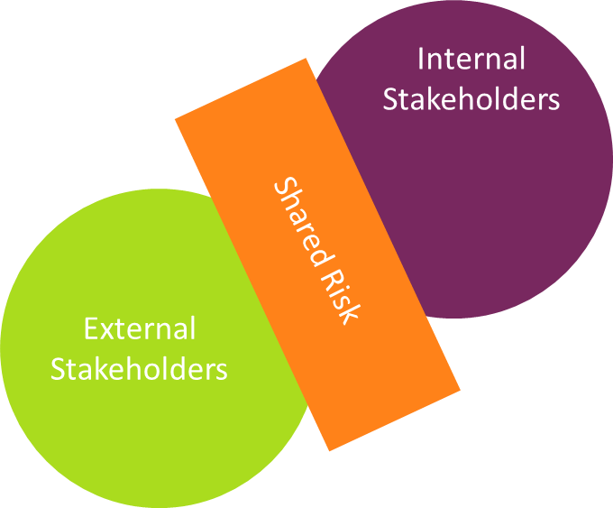
Segment stakeholders into internal and external
Internal (I): people, roles, teams, departments who will be impacted within your organisation
External (E): other agencies, organisations, departments, businesses, sporting or other recreation clubs, not-for profit groups, etc who will be impacted by the shared risk

Slide 9
Prioritise Stakeholders using Impact-Influence Matrix
Keep Informed
Manage Closely
Impact (on stakeholder)
Monitor
Keep Satisfied
Influence (on project)

Slide 10
Prioritise Stakeholders using ICIC Model
Inform
Consult
Involve
Collaborate

Slide 11
Prioritise Stakeholders using ICIC Model
Inform
To provide stakeholders with balanced and objective information to assist them in understanding the problems, alternatives, opportunities and/or solutions
Consult
To obtain stakeholder feedback on analysis, alternatives and/or decisions
Involve
To work directly with stakeholders throughout the process to ensure that stakeholder concerns and views are consistently understood and considered
Collaborate
To partner with stakeholders in each aspect of the decision including the development of alternatives and the identification of the preferred solution

Slide 12
Relationships on CPIG Chart
Governance
Provider
Client
Influencer

Slide 13
Relationships on Internal and External Chart
Internal Stakeholders
Shared Risk
External Stakeholders

Slide 14
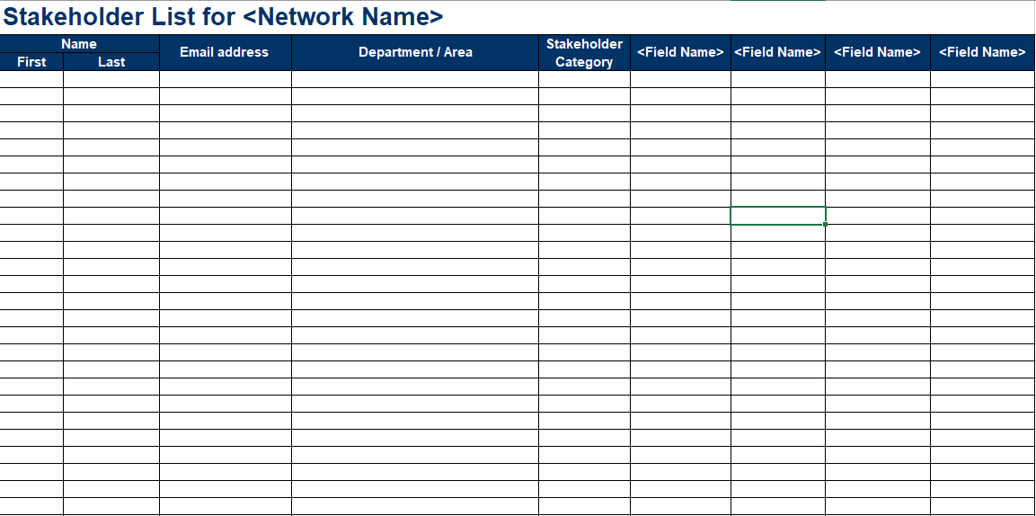
Stakeholder List template

Slide 15
Example Engagement Plan
Stakeholder | Area of interest/ influence | Segment (CPIG) | Priority | Engagement category (ICIC) | Engagement method | Frequency
DPC | Regulatory compliance | Governance | Medium | Collaborate | Face to face Emails | Frequent
DELWP | Environmental monitoring | Governance | High | Collaborate | Face to face Video conferencing | Very frequent
Indigenous leaders | Impact on land | Influencer | High | Involve | Face to face Posters | Frequent
Footy club | Use of ground during the off season | Community | Low | Inform | Face to face Newsletter | Occasional

Slide 16
Stakeholder Mapping and Engagement
SEGMENT
IDENTIFY
IDENTIFY EXISTING RELATIONSHIPS
PRIORITISE
ENGAGE

Slide 17

Next steps
  What to do next
    Reflect and actions
      Reflect on the outputs from today
      Reconvene on <date> to refine and update
      Add other workshops if required
    More information
      VMIA

Slide 18

Thank you

