Slide 1
Establish a Network Workshop
Shared risk
vmia.vic.gov.au

Slide 2

Today’s Session
Define the Network Approach to manage shared risk
Define collaboration
Work out a way to move forward
The Network Agreement
Agreement on next steps

Slide 3


What is the Network Approach?
Encourages innovation and collaboration
Supports and promotes effective communication
Improves speed, accuracy, consistency and transparency of information
Used as a risk management mechanism for engaging and supporting stakeholders
Provides opportunities to raise questions and issues
Encourages sharing of learning from previous experiences

Slide 4
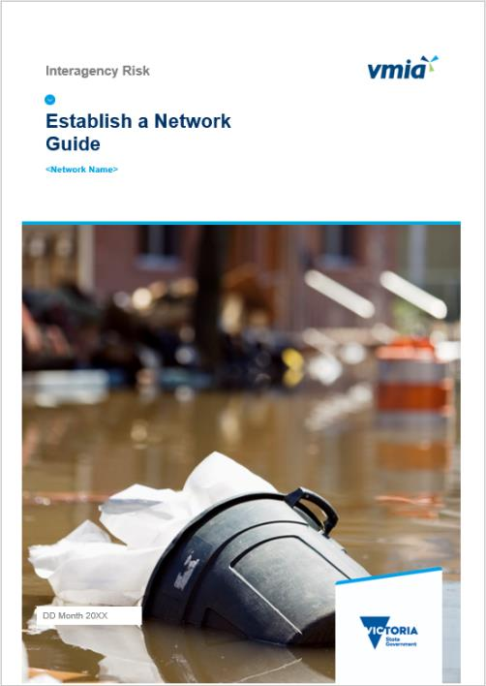
The Guide
Contents:
The four phases of the Network approach
Working together
The Network Agreement
More information

Slide 5
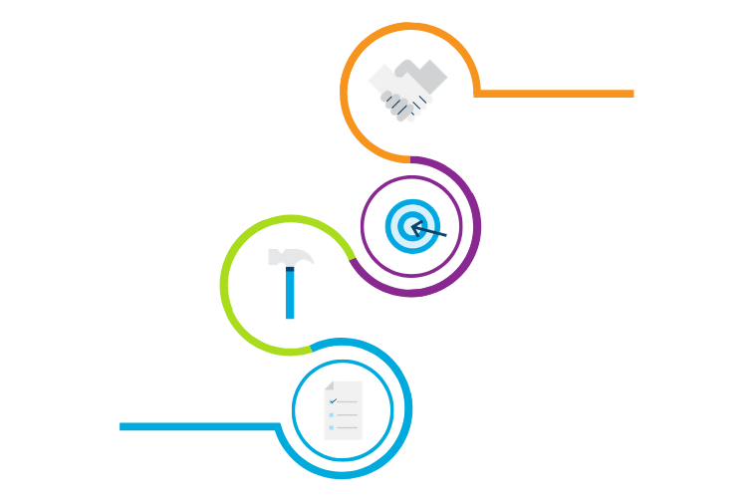
The Four Phases of the Network Approach
4. Sustain
Maintain collaboration
Issue ongoing pulse checks
3. Identify & Review
2. Build
Identify or validate risks, controls and treatments
Distribute risks, controls and treatments
Send out Initial Pulse Check
Review risks/controls as required
Establish network
1. Plan
Consult stakeholders
Set up network governance

Slide 6

Aspects of working together
The 3 Cs
Setting up the Network
Co-create values and cultural DNA
Communication
Diversity of capabilities
Adaptability
Creative freedom

Slide 7
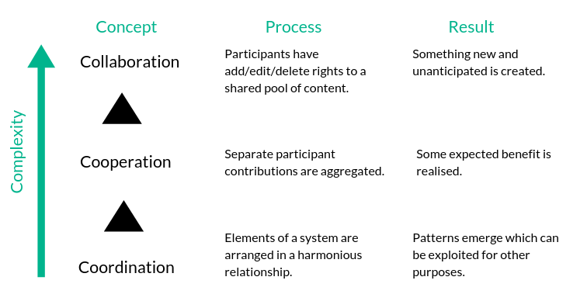
The 3 Cs
Mark Elliott: General Theory of Collaboration
Notes:
I found that collaboration was actually comprised of three interrelated but independent processes.
[READ] “Adding, editing, deleting...” (from active individual perspective)
[Examples for each: coauthoring; recycling; google]
Each of these builds upon one another, to enable and comprise the complexity that is collaboration.
So in essence...

Slide 8
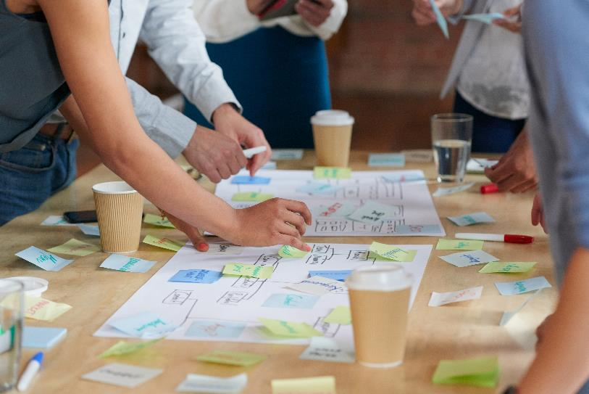
Defining collaboration
Two or more people working together towards shared goals
Creating together
Add / edit / delete rights to a shared pool of content

Slide 9

Collaboration can be challenging
Collaboration is unpredictable
Outcomes for collaboration emerge through the collaboration process
Collaboration requires agile ways of thinking and working
This can be unsettling…

Slide 10

Step 1: To collaborate or not?
Is the risk complex?
Is the possible outcome complex?
Are there many interdependencies amongst the risk owners, stakeholders or the community?
Is a creative solution required?
(As opposed to a logical solution?)
Will success be determined by your capability to collaborate?
If YES, collaborate!

Slide 11

Step 2: Establish common ground
Develop your own definition of collaboration
Develop a shared understanding of what is expected and desired from the collaboration
Agree on the obvious risks, terms, considerations and principles
Get ideas from your network

Slide 12

Collaboration activity

Slide 13
Dissonance
Competing
visions
Endless
discussion
Divergent
plans
Misunderstanding
One-sided outcomes

Slide 14
Consonance
Shared
vision
Active
Contribution
Shared
understanding
Shared
plan
Shared
outcome

Slide 15
The challenge
Competing
visions
Shared
vision
Endless
discussion
Active
Contribution
Divergent
plans
Shared
understanding
Shared
plan
Misunderstanding
One-sided outcomes
Shared
outcome
How will you...?

Slide 16

Step 3: Maintain momentum
Schedule regular collaboration sessions
Maintain a regular rhythm for your other activities eg. frequency of communications
Recognise and manage dissonance

Slide 17
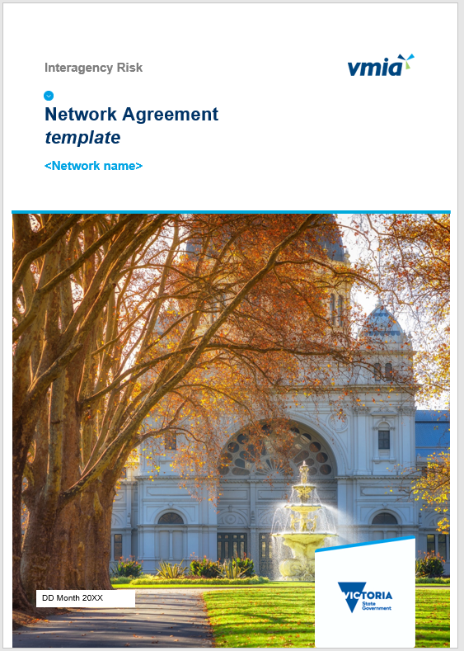
The Network Agreement
Scope
Risk identification
New risks
Deliverables
People and other resources
Working together
More information
Our commitment

Slide 18
How will our Network operate?
Shared risk
Individuals
Other government agencies
Business
Community groups
  Considerations
What have we achieved so far?
What are we trying to achieve as a group?
How will we let one another know what we need to know?
What do we need to be able to do well?
Who is responsible for what?

Slide 19

Next Steps
  What to do next
    Reflect and actions
      Reflect on the outputs from today
      Reconvene on <date> to refine and update
      Add other workshops if required
    More information
      VMIA

Slide 20

Thank you

