Slide 1
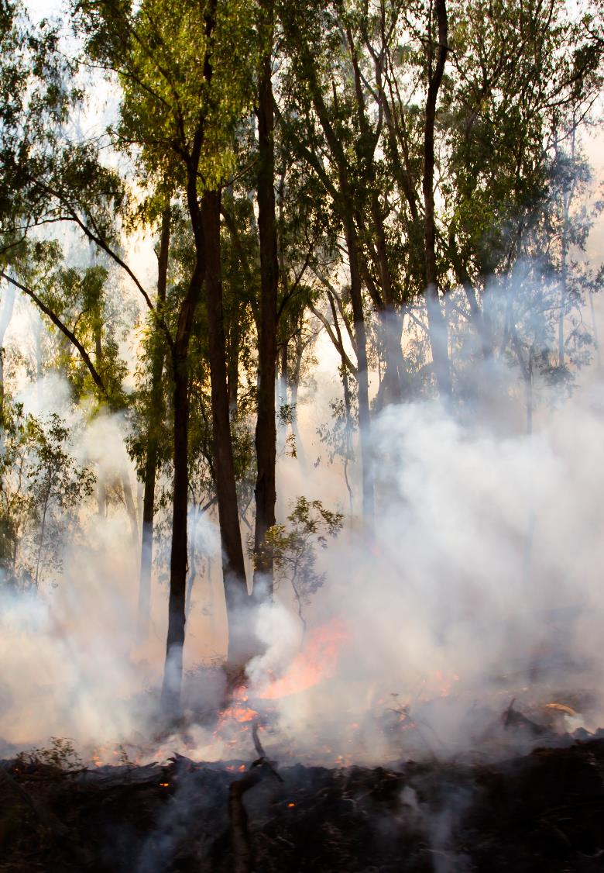

Risk Identification and Management Program (RIMP) for VMIA Clients
Phase One
Risk Identification and Analysis
<Month> 2021
vmia.vic.gov.au

Slide 2



Workshop opening

Slide 3
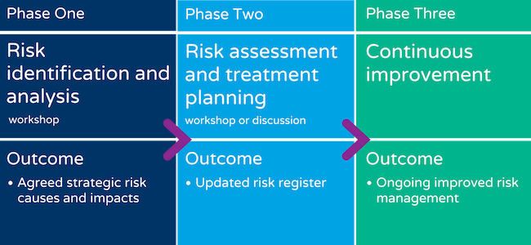
The Risk Identification and Management Program (RIMP)
We are here

Slide 4

Phase One: Workshop outcomes
  At the end of this workshop, you should have:
A standardised understanding of key risk concepts.
Identified risk events for each strategic objective and grouped them into themes or categories.
Considered shared risk implications.
Identified causes and impacts for each risk event.

Slide 5

Activity: Would you?
Optional
  Would you?
      You are on a plane at 30,000 feet and I ask you jump out. Would you?
      The plane has two engines and one is on fire. Would you now?
      One engine is on fire, you have a World War II parachute and you have had no training on how to use it. Would you now?
      One engine is on fire, you have a World War II parachute, you have had extensive training on how to use it and you have packed it yourself. Would you now?

Slide 6

Activity: Risk Management
Optional
  What does risk management mean to you?
      Draw a picture
      OR
      Create a metaphor, proverb or expression
        Example:
        A stich in time saves nine
        What is necessary is never a risk. ~ Cardinal Jean Francois de Retz
        Where there is much to risk, there is much to consider. ~ Author Unknown
        There’s no reward in life without risk. ~ Barry J. Farber

Slide 7
Sections in this workshop
  Sections (Note: Modify as required)
    Introduction to risk concepts
Identify risk categories and uncertainties
Develop risk descriptions
As we work through these topics, consider how you will apply the concepts and ideas within your organisation.

Slide 8

Section One:
Introduction to risk concepts

Slide 9

Risk is the…
‘effect of uncertainty on objectives’
AS/NZS ISO 31000:2009
Notes:
Some key questions to consider about risk and risk management:
Does risk management help you make better decisions?
Does it assist you to achieve your objectives?
Is it helping you to strengthen your governance role?
Activity: Draw a picture of what risk looks like to you
Question: Tell me why you think risk/risk management is like that

Slide 10
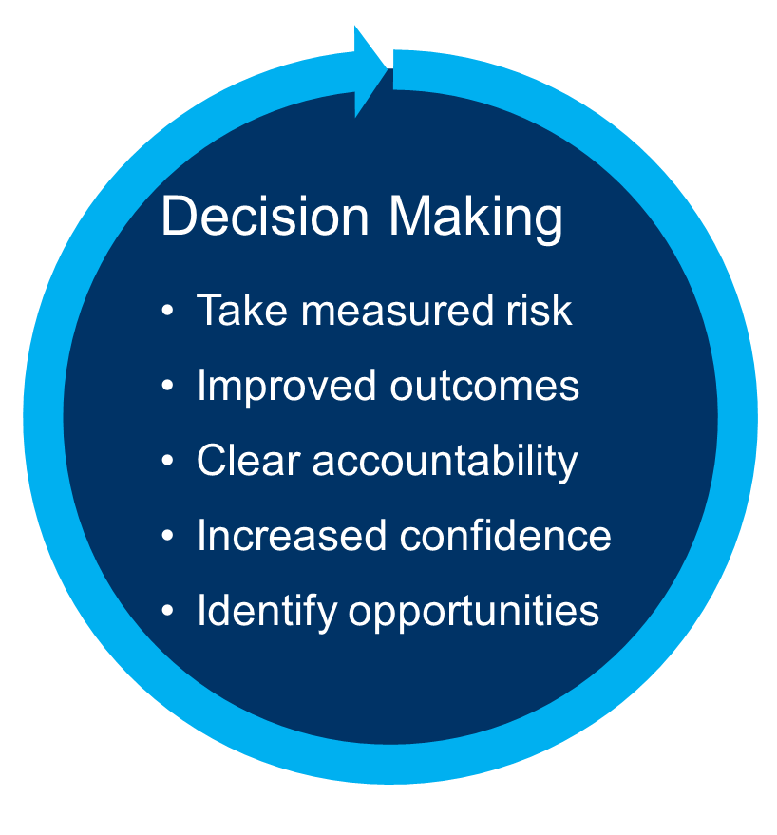
Benefits of risk management
Organisational objectives
Organisational objectives
Decision making

Slide 11
Types of risk
Strategic
  Focus is on corporate objectives
  Longer term
  Assist in decision making and building resilience
Operational
  Focus is on governance, systems and processes
Transactional
  Focus is on the day-to- day management of risks

Slide 12
Risk (and opportunities) categories
Infrastructure
Governance
Financial sustainability
Reputation
Environment
Organisational culture
Relationship management, including shared risk
Political
Safety
Workforce, clients and community
Technology and communications
Legal and compliance
Notes:
Clinical Risks related to the changing regulation of clinical care standards
Financial Risks related to funding uncertainty between Federal and State funding models and the ever increasing costs of health service delivery
Governance Risks related to gaining independent assurance of the clinical domain which is the core business of a health service. There is clear governance in the corporate domain
Inter–Agency Risks related to the need to strategically partner with other organisations to meet service demands. There are existing challenges to coordinating risk identification and sharing the risk between Health Services
Workforce Risks related to maintaining a highly skilled workforce to meet service demand
Information Technology & Communication Risks related to ensuring privacy and confidentiality of data and avoiding fraud

Slide 13
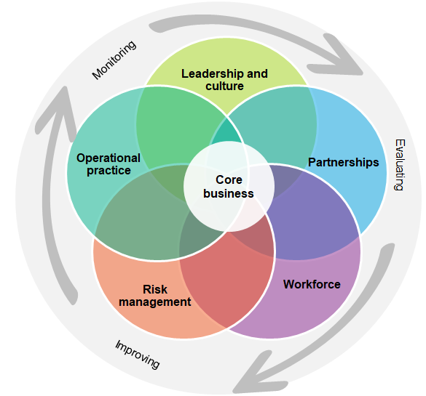
The five domains of governance
  Five domains of governance
      Leadership and culture
        Visible, ethical and accountable
        Open to bad news
      Partnerships
        Clients, families and the community are involved
      Workforce
        Engaged and appropriately trained staff
      Risk management
        Understand areas of risk including: financial, legal/compliance
      Operational practice
        Appropriate systems, knowledge, skills, equipment
Based on: Safer Care Victoria (2017)
Delivering high-quality healthcare

Slide 14

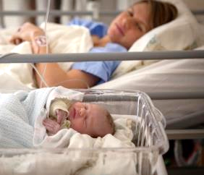
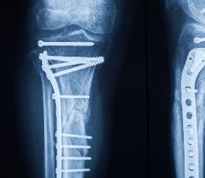


Patient safety themes
Health only
Patient’s voice
Transparency
Improved clinical practice
Governance structures
Board’s role

Slide 15
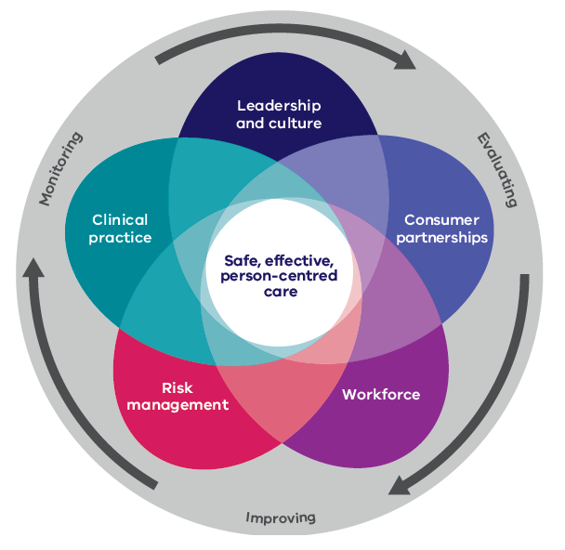
The five domains of clinical governance
Health only
  Five domains of clinical governance
      Leadership and culture
        Visible, accountable and ethical
        Open to bad news
      Consumer partnerships
        Patients, families, carers, the community are involved
      Workforce
        Engaged and appropriately trained staff
      Risk management
        Understanding of areas of risk
      Clinical practice
        Appropriate systems, knowledge, skills, equipment
Source: Safer Care Victoria (2017)
Delivering high-quality healthcare

Slide 16
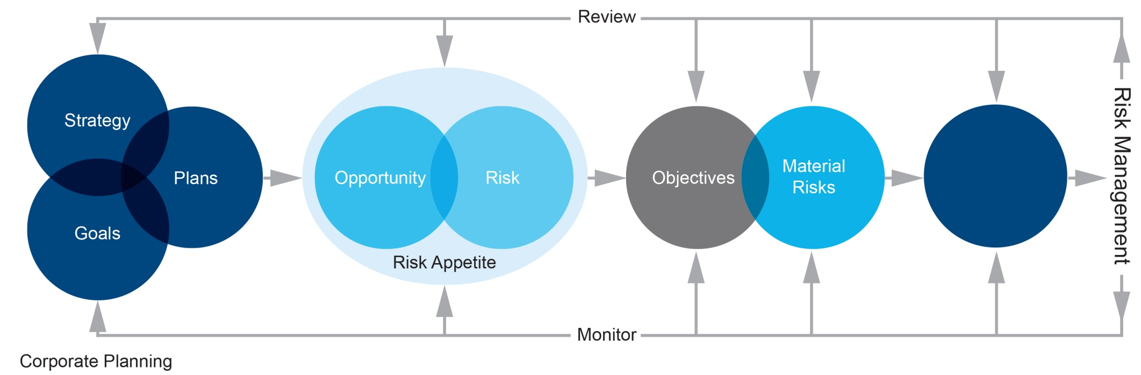
Strategic risk management process
Material risks
Controls and treatment
Risk management
Risk appetite
Corporate planning
How much risk to take/accept
Risk identification and assessment
Risk treatment

Slide 17
Strategic risk management process
Health only
Material risks
Controls and treatment
Risk management
Risk appetite
Corporate planning
How much risk to take/accept
Risk identification and assessment
Risk treatment
Our clients
Our people
Our organisation
Our financial sustainability
Our legal requirements
Our community
Example: Clinical service delivery: Palliative Care Gap
Financial:
Insufficient budget
Clinical:
No model of care
People:
Lack of workforce
Financial:
Cost reduction plan
Clinical:
Model of care development
People
Workforce plan
Appetite:
Opportunity to further develop cancer and palliative care services
Tolerance categories:
Financial: limited to 3% overspend
Patient safety: Nil – meet targets
Our people: Meet safety and engagement targets

Slide 18
Strategic risk management process
OR
Risk assessment: identification and analysis
Strategic and operational risks
Strategic objectives
Strategic actions
Controls and treatments
Risk appetite
Opportunity
Tolerance
Corporate planning
Consider and evaluate the options
How much risk to take/accept

Slide 19

Leadership and culture
  What is culture?
      Shared beliefs, attitudes, values, ethics and behaviours
      Why is culture important?
      Indicates an organisation’s priorities:
        Customers, clients, patients, the community
        Employees
        Safety
        Making profit, cost cutting
        Innovation
    Impacts how values are played out:
        What is acceptable and what can be discussed
        Drives behaviour
        Creates a setting for reporting (or not reporting) and whistle-blowing
        What an organisation says it stands for, compared to what it actually does
Is the culture you have, the culture you want?

Slide 20

A positive risk culture is one where every person in the agency believes that thinking about and managing risk is part of their job.
VGRMF 2015

Slide 21
Describing a risk
Describe the risk
Event
Resignation of key employees.
Causes
Poor culture, remuneration is uncompetitive, poor management practices, inadequate career development.
Impacts
Increased strain on remaining staff, low staff morale, difficulty in maintaining day-to-day operations.

Slide 22
Risk Bow tie
Objective:
Causes
Prevention controls: reduce likelihood before the event
Detection controls: reduce impact after the event
Impacts
Reason or trigger
Impacts or consequences
Event
Reason or trigger
Risk of an undesirable incident or event
Impacts or consequences
Reason or trigger
Impacts or consequences
Treatments: reduce likelihood or impact for next time

Slide 23
Risk Bow Tie (Health) example
Objective: To offer high quality cancer and palliative care to our community
Causes
Prevention controls: reduce likelihood before the event
Detection controls: reduce impact after the event
Impacts
Insufficient budget to resource new service
Availability of care to community
Event
Lack of expertise in the field
The new cancer and palliative care service is not able to deliver adequate care
Reputational damage
No existing model of care for cancer and palliative care services
Waste of investment in new services
Treatments: reduce likelihood or impact for next time

Slide 24
Risk Bow Tie example
Workforce objective: Attract and retain the best people
Prevention controls and treatments to reduce likelihood
Detection controls and treatments to reduce impact
Causes
Impacts
Remuneration is uncompetitive
Event that could/does affect objective
Increased strain on remaining staff
Resignation of key employees
Poor organisational culture
Low staff morale
Poor management practices
Difficulty in maintaining day-to-day operations
Inadequate career development

Slide 25

Section Two:
Identify risk categories and uncertainties

Slide 26
Risk (and opportunities) categories
Infrastructure
Governance
Financial sustainability
Reputation
Environment
Organisational culture
Relationship management, including shared risk
Political
Safety
Workforce, clients and community
Technology and communications
Legal and compliance
Notes:
Clinical Risks related to the changing regulation of clinical care standards
Financial Risks related to funding uncertainty between Federal and State funding models and the ever increasing costs of health service delivery
Governance Risks related to gaining independent assurance of the clinical domain which is the core business of a health service. There is clear governance in the corporate domain
Inter–Agency Risks related to the need to strategically partner with other organisations to meet service demands. There are existing challenges to coordinating risk identification and sharing the risk between Health Services
Workforce Risks related to maintaining a highly skilled workforce to meet service demand
Information Technology & Communication Risks related to ensuring privacy and confidentiality of data and avoiding fraud

Slide 27

Shared and State-significant risk
Optional
Shared and State-significant risks are typically shared by two or more agencies, where a shared objective or key dependency exists.
VGRMF
Notes:
Under the VGRMF
It is generally not
- Public and private partnerships
-Third party contractors or suppliers
-Outsourced arrangement to a non government entity
Example – Fire risk
Delwp
Parks vic
Emv
Councils
Cfa
Mfb
Vicpolice
As a board do you see shared risk relevant to your organisation?
Discussion
Department level
Other CSO organisations?

Slide 28
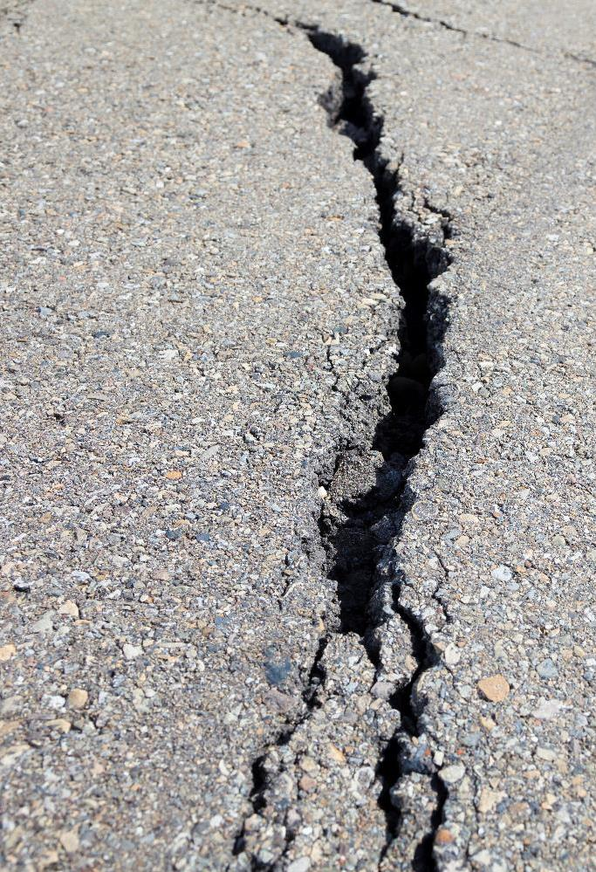
Section Three:
Risk causes and impacts

Slide 29
Risk Bow Tie
Objective:
Causes
Impacts
Reason or trigger
Impacts or consequences
Event
Reason or trigger
Risk of an undesirable event
Impacts or consequences
Reason or trigger
Impacts or consequences

Slide 30

Workshop close

Slide 31
Summary
  Sections
    Risk concepts
Risk categories and uncertainties
Risk causes and impacts
What are your key learnings from today’s workshop?

Slide 32

Phase One: Workshop outcomes
  We hope you now have:
An agreed understanding of key risk concepts
Identified risk events for each strategic objective and grouped them into themes or categories
Considered shared risk implications
Identified causes and impacts for each risk event

Slide 33
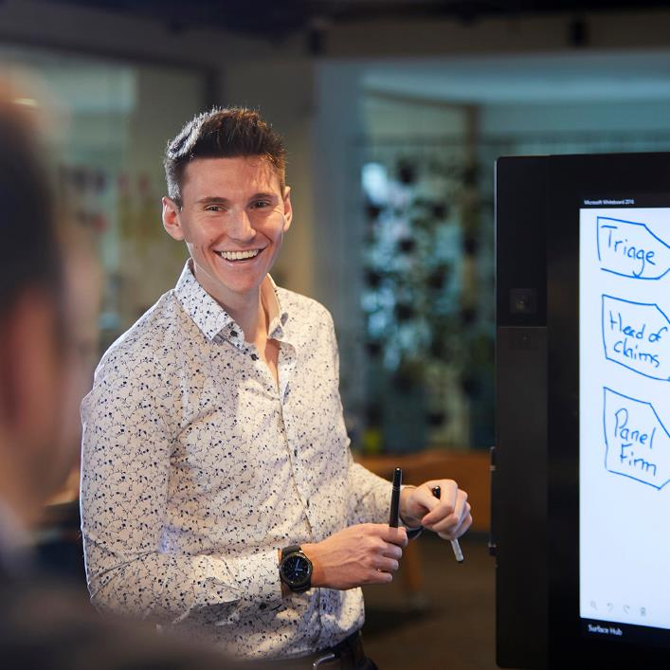
Next steps
  What to do next
    Reflect
      What insights from this workshop are you going to share with other members of staff?
      How are you going to share that information?
      What actions do we need to take now?
    More information
      VMIA

Slide 34
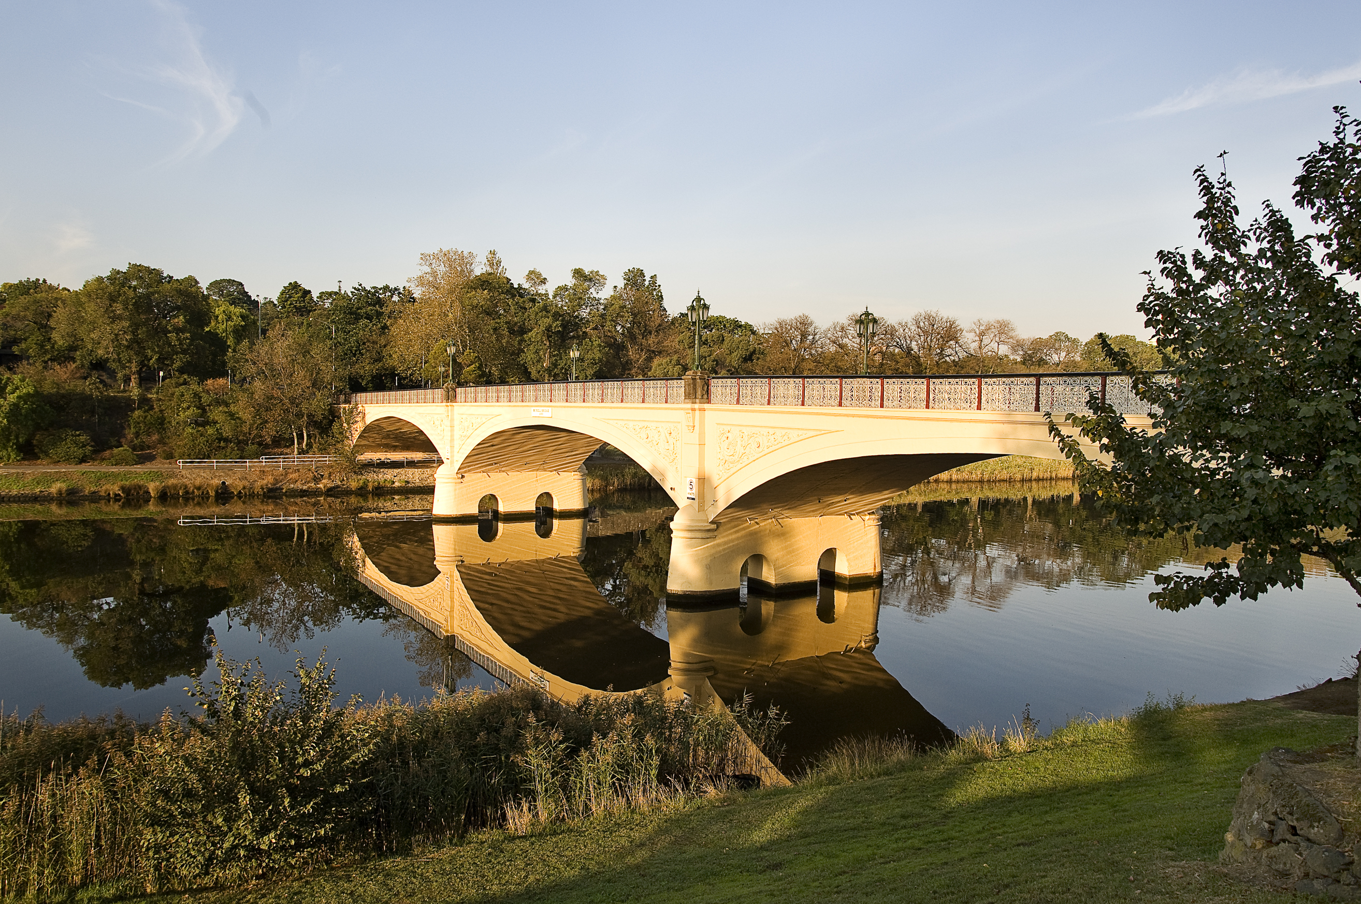
Thank you

