Slide 1


Risk Identification and Management Program (RIMP) for VMIA Clients
Phase Two
Risk Assessment and Treatment Planning
<Month> 2021
vmia.vic.gov.au

Slide 2



Workshop opening

Slide 3
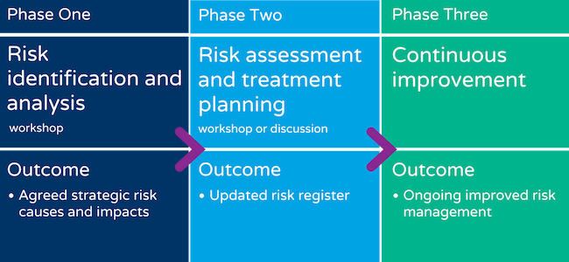
The Risk Identification and Management Program (RIMP)
We are here

Slide 4

Phase Two: Workshop outcomes
  At the end of this workshop, you should have:
Identified controls
Identified control owners
      Rated the effectiveness of controls using your control effectiveness rating criteria
      Rated each risk according to your risk rating criteria
      Identified treatment plans

Slide 5
Sections in this workshop
  Sections
    Identify controls
    Control effectiveness
    Risk rating
Treatment planning
As we work through these topics, consider how you will apply the concepts and ideas within our organisation.

Slide 6
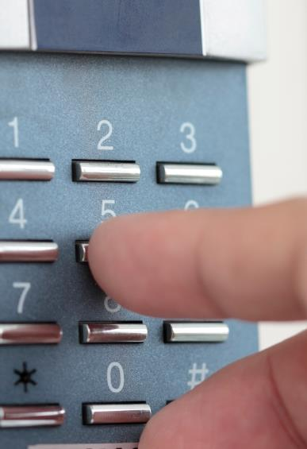
Section One:
Control identification

Slide 7
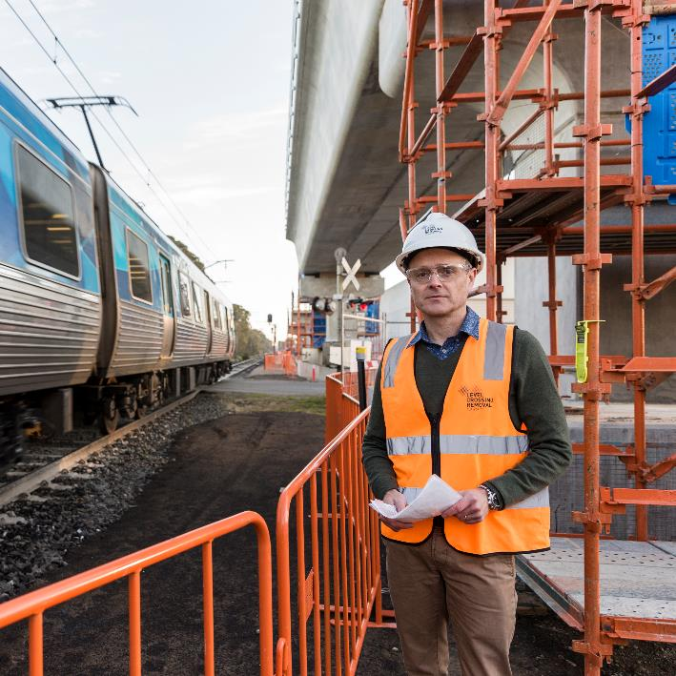
What is a control?
A control is…
“…a measure that is modifying risk – controls include any process, policy, device, practice or other actions which modify risk.
Controls may not always exert the intended or assumed modifying affect.”
AS/NZS ISO 31000:2009

Slide 8

Controls
  Controls
…are a measure or action taken to modify a risk now.
They include:
      Legislation
      Governance
      Reporting
      Policies and procedures
      Qualifications
      Training
      WHS/OHS representatives

Slide 9
Prevention and detection controls
Objective:
Causes
Prevention controls: reduce likelihood before the event
Detection controls: reduce impact after the event
Impacts
Reason or trigger
Impacts or consequences
Event
Reason or trigger
Risk of an undesirable incident or event
Impacts or consequences
Reason or trigger
Impacts or consequences
Treatments: reduce likelihood or impact for next time

Slide 10
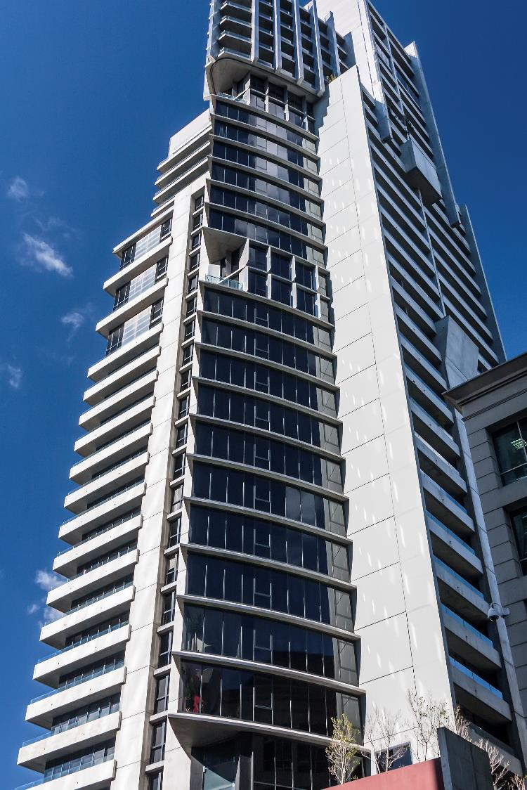
Section Two:
Control effectiveness

Slide 11

Control rating
  Definition
  A control rating is an indication of how effective the control is.
  It will be effective, partially effective or ineffective based on your organisation's control effectiveness rating criteria.

Slide 12
Assess the effectiveness of the controls
  Controls
A measure or action taken to modify a risk now. They include:
      Legislation
      Governance
      Reporting
      Policies and procedures
      Qualifications
      Training
      WHS/OHS representatives
    Important: Controls need to be reviewed and assessed to check they are effective.
  Assess controls
To evaluate the effectiveness of your controls, consider:
      Self-assessment
      Review of errors and incidents
      Root-cause analysis
      Insurance claims
      Insights from other agencies or sectors
      Benchmarks
      Modelling
      Reviews by specialist auditors and assessors

Slide 13

Section Three:
Risk rating

Slide 14

Risk rating
A risk rating is based on the likelihood and consequence of a risk occurring.

Slide 15
Likelihood risk rating (example only)
Likelihood rating | Likelihood | Event with its associated consequences
Tier 5 | Almost certain | The event is expected to occur as there is a history of regular occurrence at the organisation and/or similar institutions, or new conditions make it very likely to occur.
Tier 4 | Likely | There is a strong possibility the event will occur as there is a history of frequent occurrence at the organisation or similar institutions, or new conditions make it likely to occur.
Tier 3 | Possible | The event might occur at some time as there is a history of casual occurrence at the organisation or similar institutions, or new conditions make it possible to occur.
Tier 3 | Unlikely | The event is not expected and has not casually occurred before, but there is a small possibility it may occur at some time in certain circumstances.
Tier 1 | Rare | The event is highly unlikely. It may occur in exceptional circumstances but has never occurred before. It could happen, but probably never will.
These descriptions for likelihood and consequence are from VMIA’s B2 Risk Criteria Examples risk management tool

Slide 16
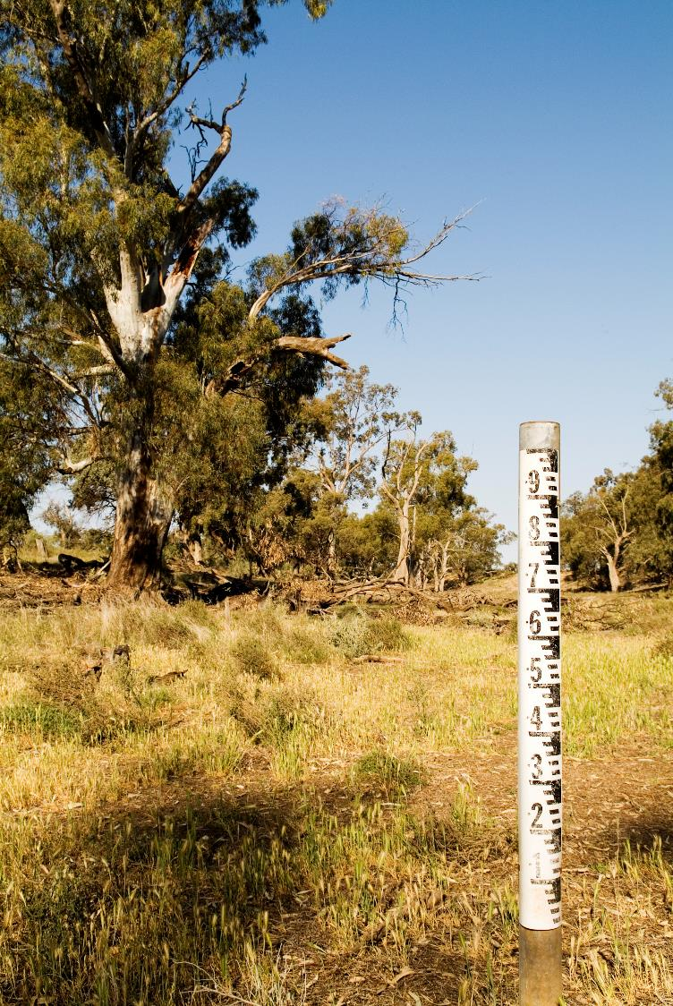
Section Four:
Treatment planning

Slide 17
Risk treatment plan
A risk treatment plan is an ‘action plan’ for future controls.
They may be for risks that:
haven’t got controls
have ineffective controls
It specifies:
controls that will be implemented
who is responsible for each control
implementation deadlines
the resources required (i.e. financial and human)

Slide 18
Risk treatment plan
  Treatments include:
      Avoid
      Remove
      Change the likelihood or consequences
      Taking the risk by informed decision or to pursue an opportunity
      Transfer or share the risk (eg. via insurance)

Slide 19

Workshop close

Slide 20
Summary
  Topics
    Identify controls
    Control effectiveness
    Risk rating
Treatment planning
What are your key learnings from today’s workshop?

Slide 21

Phase 3 workshop outcomes
  You should now have:
Identified controls
Identified control owners
      Rated the effectiveness of controls using your control effectiveness rating criteria
      Rated each risk according to your risk rating criteria
      Identified treatment plans

Slide 22
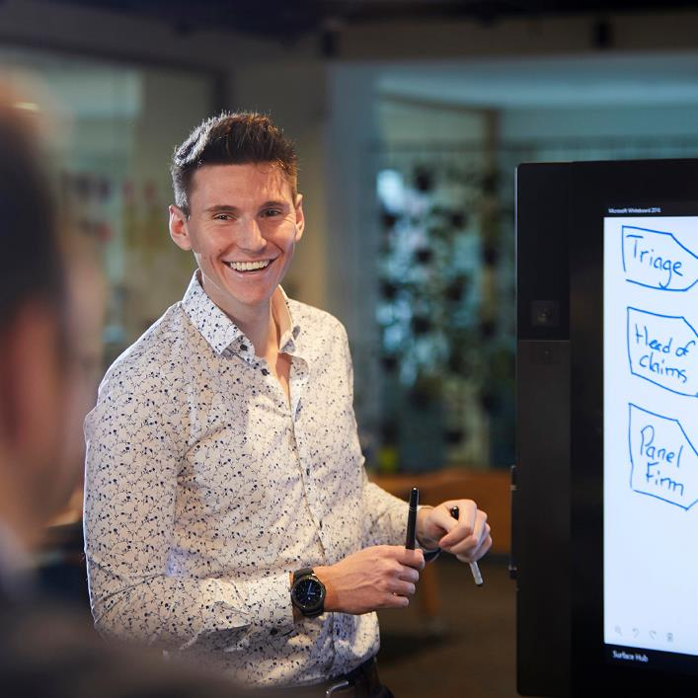
Next steps
  What to do next
    Reflect
      What insights from this workshop are you going to share with other members of our staff?
      How are you going to share that information?
      What actions do we need to take now?
    More information
      VMIA

Slide 23
Thank you

