Slide 1
Considering climate change risks
For Senior Managers, Board members
This slide pack tool is intended as a guide to help you with your presentations to the board
Notes:
This presentation isn’t branded so you can use your own style. Refer to VMIA’s guidance materials for information about climate change risk management.

Slide 2
Guidance
To address climate change risks we should consider:
What are our obligations and gaps?
What are climate change risks?
Who is responsible?
How do we address climate change risks?
What are the benefits?
Our actions and commitment
Key message
Climate change is a mainstream risk we need to address
Notes:
Use these suggested headings to structure your presentation or define your own.

Slide 3
Guidance
How do we address climate change risks?
      Identify existing risks in our risk register
      Apply climate change as a multiplier to our existing risks
      Consider short-, medium- and long-term
      Explore both physical and transition risks
      How does this affect our risk appetite?
      Suppliers and other agencies share our risks
Key message
Use our risk management framework and consider a range of timeframes
Notes:
These are the key general points about climate change risk management.
Main speaking point
The main speaking point is that you should consider both physical and transition risks over a range of timeframes using your existing risk management framework.
Other speaking points
Your organisation might need to:
Revisit existing risks
Adapt your risk assessments to cater for longer timeframes for some climate change risks
Have conversations with suppliers, agencies and your community
Reconsider your organisation’s risk appetite

Slide 4
Guidance
Consider below for your climate change risk assessment
Scope
Determine the objectives, functions and activities to assess
Assess
Review the risk register to assess how climate change is already handled
Report
Confirm risk management strategy and resource allocation
Report risks to Executive and Board with any new plans to treat them
Confirm
And / or add any new physical or transition risks
Notes:
While we recommend using (and potentially adapting) your existing risk management framework to handle climate change risks, this simple 4-step process might help get the message across to your leaders easily.

Slide 5
Sample slides that you can use

Slide 6
What are our obligations and gaps?
VGRMF
Financial Management Act
Public Administration Act
Climate Change Act
Key message
Are there gaps? What steps do we need to take to address these?
Notes:
It makes sense to lay out the compliance ‘must do’ for your organisation when it comes to managing climate change risks.
Use our guide Understanding Victorian climate change risk management expectations to help.
Also check if your own organisation or portfolio in government has its own specific guidance on managing climate change risks.

Slide 7
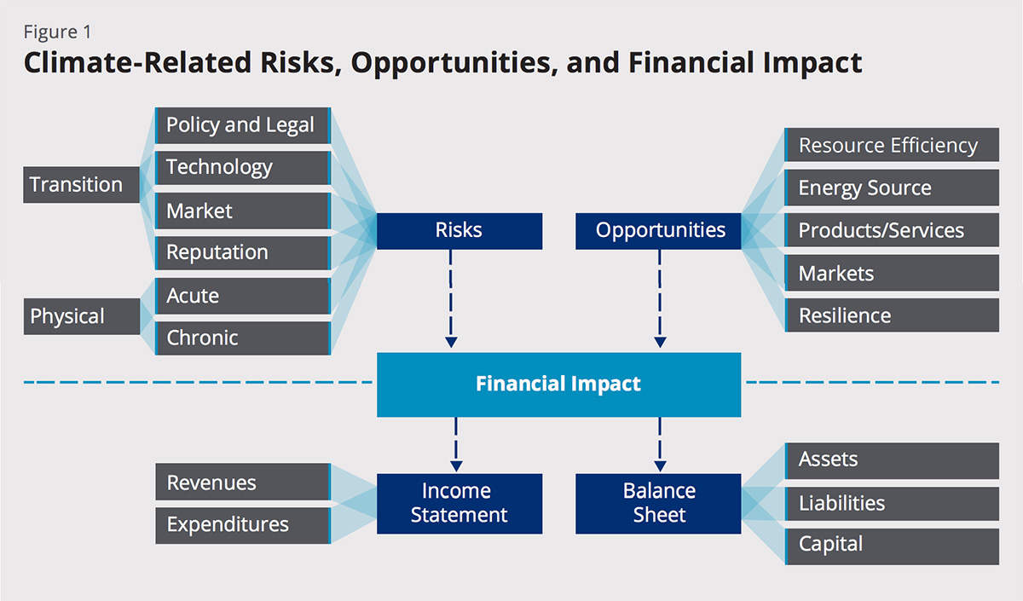
What are climate change risks?
Key message
Physical and transition risks exist to our objectives, functions and activities
Source: Task Force on Climate-related Financial Disclosures (TCFD), 2017, final report
Notes:
Climate change can present new risks or multiply risks you already know about.
Climate change risks include both physical risks and transition risks.
Use VMIA’s guide Exploring Victoria’s climate change risks for more ideas.
To find out more about financial disclosure, visit the Task Force on Climate-related Financial Disclosures https://www.fsb-tcfd.org/ .

Slide 8
What are our physical risks?
Notes:
Physical risks of climate change will affect your organisation differently depending on its activities and geographic location. Consider both acute and chronic risks.

Slide 9
What are our transition risks?
Notes:
Your transition risks can be Policy & Legal, Technology, Market and Reputation.
Use VMIA’s guide Exploring Victoria’s climate change risks to get started.
If you’d like to explore transition risk in more detail we recommend TCFD’s publication on risk management.
https://assets.bbhub.io/company/sites/60/2020/09/2020-TCFD_Guidance-Risk-Management-Integration-and-Disclosure.pdf

Slide 10
What are the benefits?
Better informed decision making
1
Better resource prioritisation
2
Better long term planning with long tail climate change risk
3
Better performance against objectives
4
More resilient
5
Notes:
Use this slide to talk about the benefits of managing climate risks.

Slide 11
Our actions and commitment
Notes:
Use this slide to put down the key elements of what you’ll do next. Examples could include:
Commitment for all business units to consider their physical and transition risks
Plan to look beyond normal planning horizons and ensure climate change is considered as part of strategic planning
Agreement to act on any significant climate change risks
Plan to tailor the existing risk management framework if needed
Plans to incorporate climate change action in supplier agreements, etc

